Slide 1
Notes:
\mathbf{D}_\mathrm{mr}
\mathbf{D}_\mathrm{cnn}
\Im(\mathbf{p}_{\mathrm{cnn},\mathrm{cp}}(\omega))
\Re(\mathbf{p}_{\mathrm{cnn},\mathrm{cp}}(\omega))
\Im(\mathbf{p}_{mathrm{cp))}
\Re(\mathbf{p}_{mathrm{cp}}

Slide 2
Notes:
\mathbf{D}_\mathrm{mr}
\mathbf{D}_\mathrm{cnn}
\Im(\mathbf{p}_{\mathrm{cnn},\mathrm{cp}}(\omega))
\Re(\mathbf{p}_{\mathrm{cnn},\mathrm{cp}}(\omega))
\Im(\mathbf{p}_{mathrm{cp))}
\Re(\mathbf{p}_{mathrm{cp}}

Slide 3
Notes:
\mathbf{D}_\mathrm{mr}
\mathbf{D}_\mathrm{cnn}
\Im(\mathbf{p}_{\mathrm{cnn},\mathrm{cp}}(\omega))
\Re(\mathbf{p}_{\mathrm{cnn},\mathrm{cp}}(\omega))
\Im(\mathbf{p}_{mathrm{cp))}
\Re(\mathbf{p}_{mathrm{cp}}

Slide 4
Notes:
\mathbf{D}_\mathrm{mr}
\mathbf{D}_\mathrm{cnn}
\Im(\mathbf{p}_{\mathrm{cnn},\mathrm{cp}}(\omega))
\Re(\mathbf{p}_{\mathrm{cnn},\mathrm{cp}}(\omega))
\Im(\mathbf{p}_{mathrm{cp))}
\Re(\mathbf{p}_{mathrm{cp}}

Slide 5
Notes:
\mathbf{D}_\mathrm{mr}
\mathbf{D}_\mathrm{cnn}
\Im(\mathbf{p}_{\mathrm{cnn},\mathrm{cp}}(\omega))
\Re(\mathbf{p}_{\mathrm{cnn},\mathrm{cp}}(\omega))
\Im(\mathbf{p}_{mathrm{cp))}
\Re(\mathbf{p}_{mathrm{cp}}

Slide 6
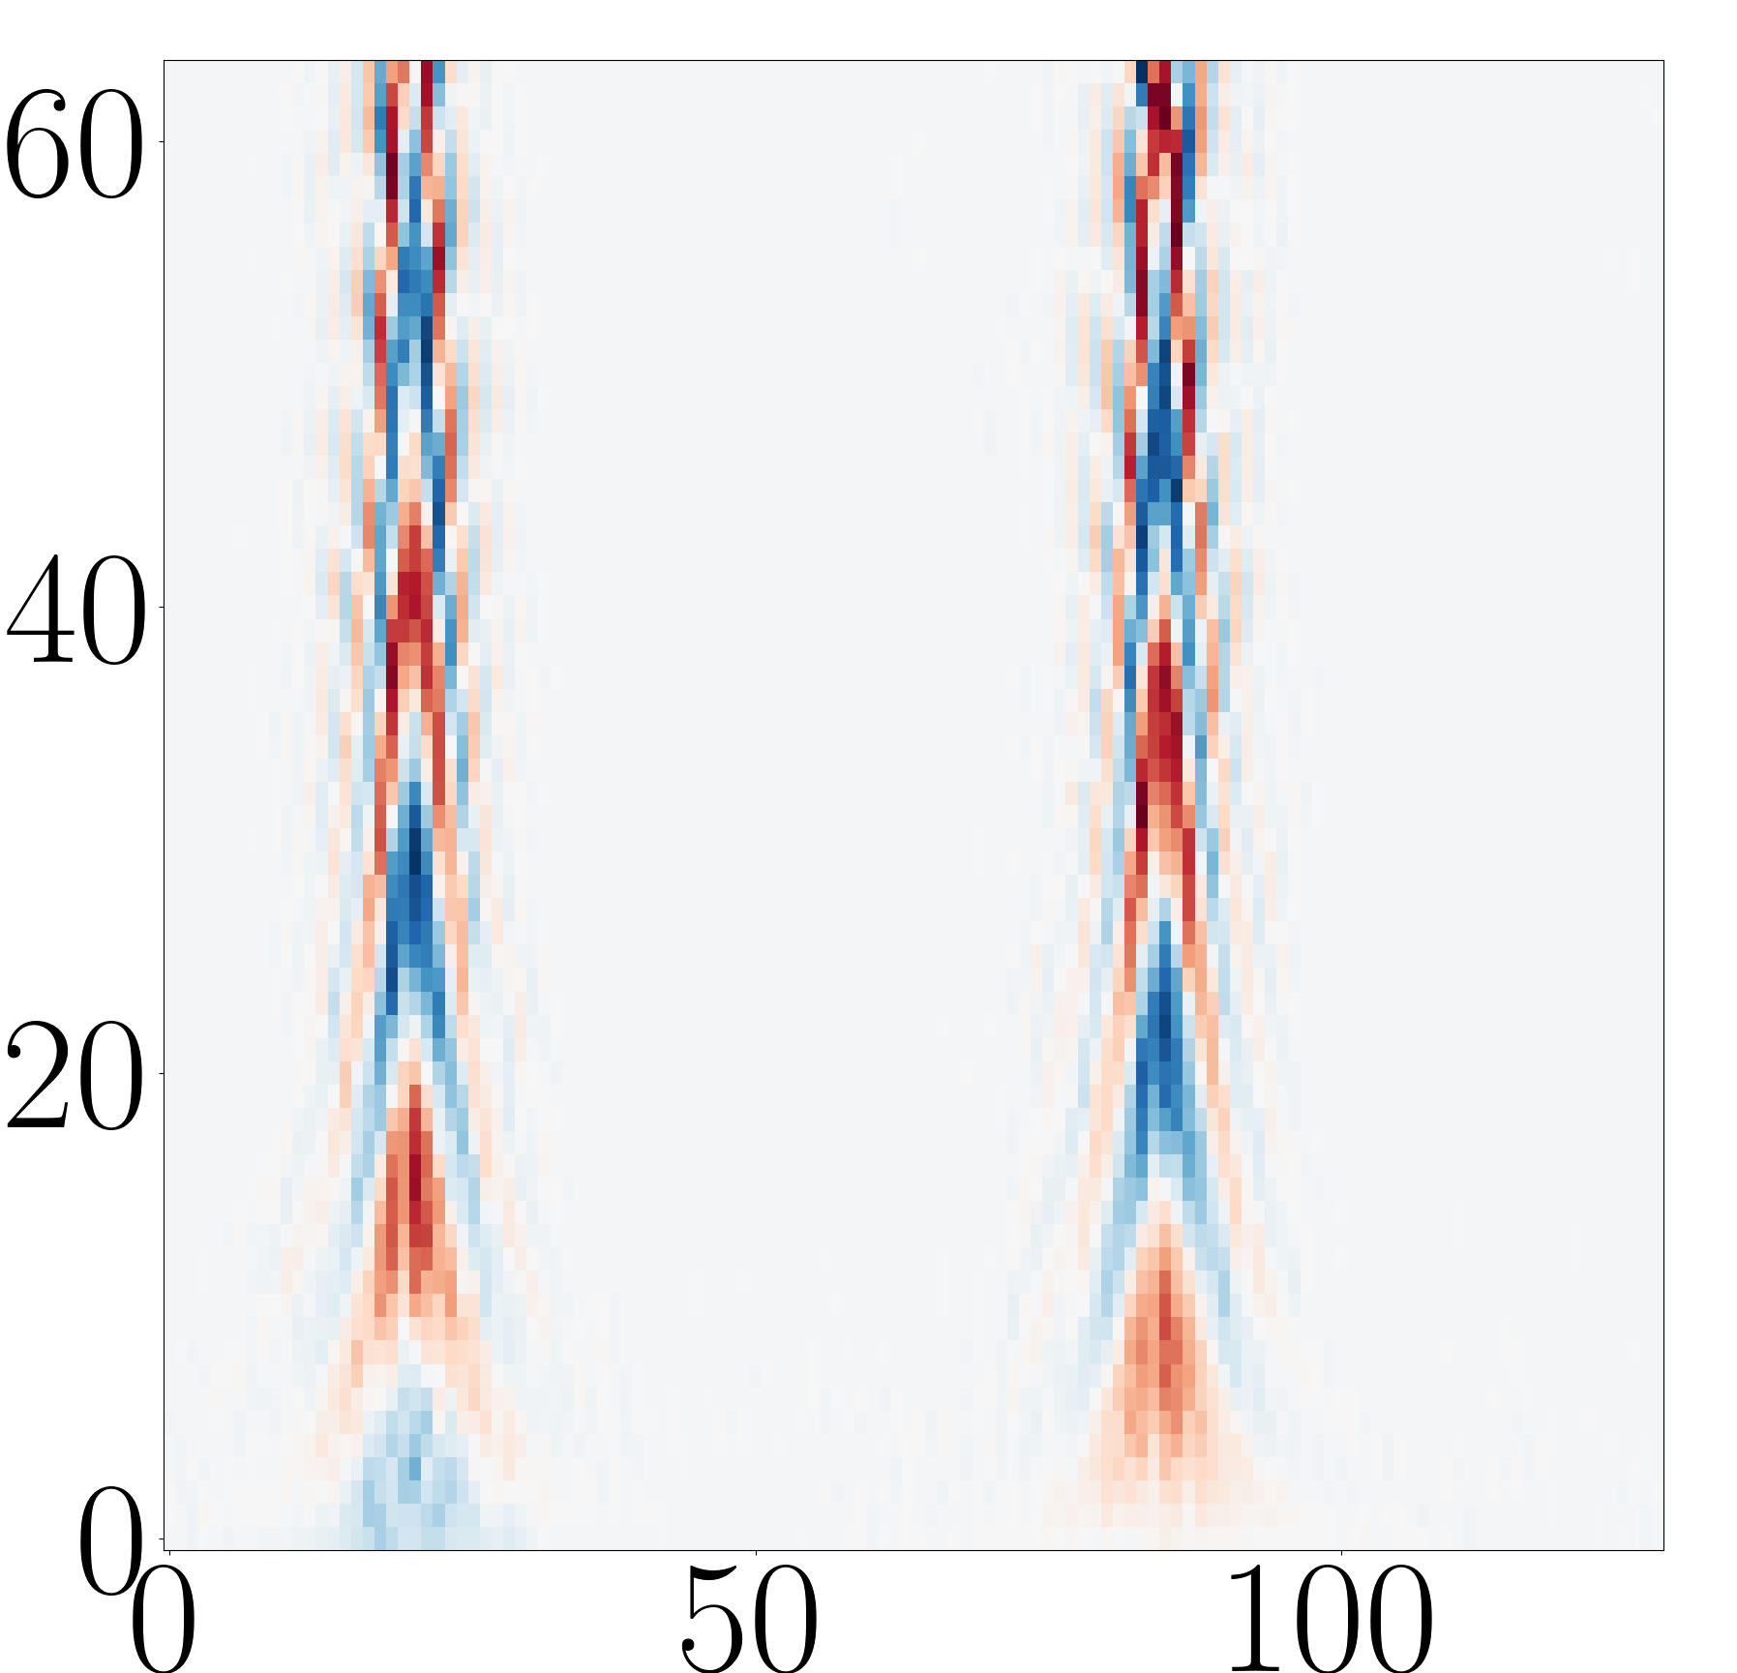
Notes:
\mathbf{D}_\mathrm{mr}
\mathbf{D}_\mathrm{cnn}
\Im(\mathbf{p}_{\mathrm{cnn},\mathrm{cp}}(\omega))
\Re(\mathbf{p}_{\mathrm{cnn},\mathrm{cp}}(\omega))
\Im(\mathbf{p}_{mathrm{cp))}
\Re(\mathbf{p}_{mathrm{cp}}

Slide 7
Notes:
\mathbf{D}_\mathrm{mr}
\mathbf{D}_\mathrm{cnn}
\Im(\mathbf{p}_{\mathrm{cnn},\mathrm{cp}}(\omega))
\Re(\mathbf{p}_{\mathrm{cnn},\mathrm{cp}}(\omega))
\Im(\mathbf{p}_{mathrm{cp))}
\Re(\mathbf{p}_{mathrm{cp}}

Slide 8
Notes:
\mathbf{D}_\mathrm{mr}
\mathbf{D}_\mathrm{cnn}
\Im(\mathbf{p}_{\mathrm{cnn},\mathrm{cp}}(\omega))
\Re(\mathbf{p}_{\mathrm{cnn},\mathrm{cp}}(\omega))
\Im(\mathbf{p}_{mathrm{cp))}
\Re(\mathbf{p}_{mathrm{cp}}

Slide 9
